Slide 1
Rise of Industrial America
Page 530
Chapter 24

Slide 2
Henry Bessemer-Steelmaking Process!!
6

Slide 3
George Pullman= Pullman Sleeping Car Pullman Strike of 1894

Slide 4
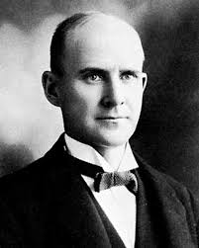
1893-1894: start of a depression. Cut wages by 30% (but didn’t cut rent). Increased hours.
&9.07 in 2 weeks. Rent $9. 7 cents left.
6% to investors
Workers strike led by Eugene Debs. Federal troops sent. 34 workers killed. Courts side with owner.
Investigating commission blames Pullman
Pages 617-618

Slide 5
Alexander Graham Bell 3-10-1876 “Mr. Watson-come here-I want to see you.”

Slide 6
Andrew Carnegie

Slide 7
Thomas Edison phonograph, motion picture camera, long-lasting electric light bulb

Slide 8
J.P. Morgan-formed GE (General Electric)-transformed American business

Slide 9
John D. Rockefeller

Slide 10
Thomas Nast
8

Slide 11
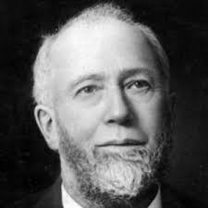
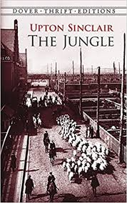
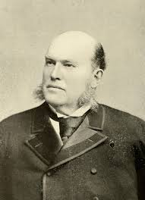
Swift and Armour (meatpacking out of Chicago)
Gustavus Swift: revolutionized meatpacking by using refrigerated railroad cars, cost controls at factories, & vertical integration
Philip Armour
Upton Sinclair’s The Jungle

Slide 12
Cornelius Vanderbilt

Slide 13
Industrializatiion Movement from rural to urban. Effects????
7
Overcrowding?
Sanitation?
Disease?
Low wages
Working conditions
Child labor

Slide 14
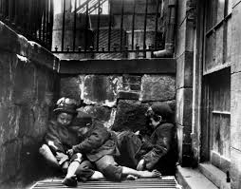
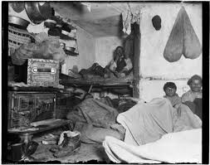
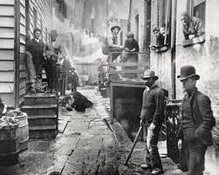
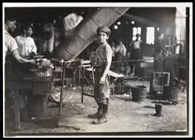
Jacob Riis=exposed living conditions!
9
How the Other Half Lives

Slide 15
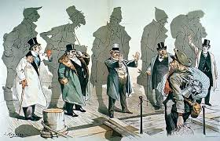
“Old” vs. “New” Immigrants What’s the difference? Their origins!
9
1880-1920
“New” immigrants
From Eastern & Southern Europe. Mostly Catholic or Jewish or Orthodox.

Slide 16
9

Slide 17
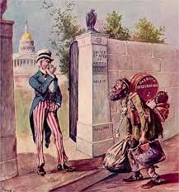
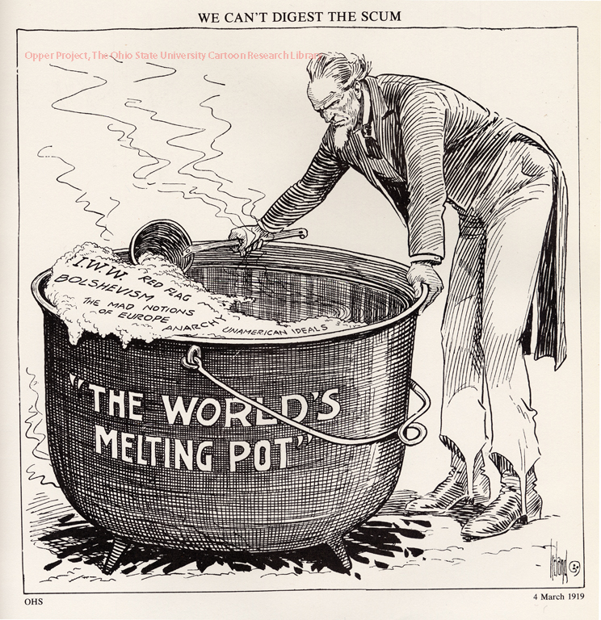
Rise of Nativism
9
Defn: the policy of protecting the interests of native-born or established inhabitants against those of immigrants.

Slide 18
Thomas Nast
9
Chinese Exclusion Act 1882 (page 517). Repealed 1943

Slide 19
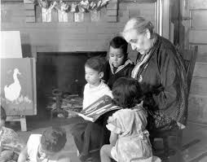
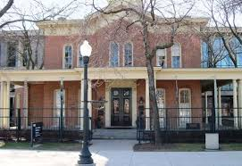
Jane Addams’ Hull House
9
1889: Settlement House in Chicago
for new European immigrants
Twenty Years at Hull House

Slide 20
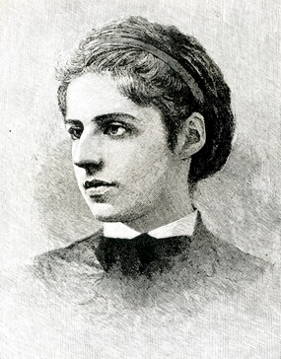
The New Colossus
BY EMMA LAZARUS (1883)
Not like the brazen giant of Greek fame,
With conquering limbs astride from land to land;
Here at our sea-washed, sunset gates shall stand
A mighty woman with a torch, whose flame
Is the imprisoned lightning, and her name
Mother of Exiles. From her beacon-hand
Glows world-wide welcome; her mild eyes command
The air-bridged harbor that twin cities frame.
“Keep, ancient lands, your storied pomp!” cries she
With silent lips. “Give me your tired, your poor,
Your huddled masses yearning to breathe free,
The wretched refuse of your teeming shore.
Send these, the homeless, tempest-tost to me,
I lift my lamp beside the golden door!”

